Slide 1


Slide 2




Managing device access to your company data without enrollment
Jan Ketil Skanke
Principal Cloud Architect
MVP Enterprise Mobility
Twitter: @JankeSkanke

Slide 3
Who and how are they accessing your data?
Employees
Secure and protect against new threats
Business partners
Maximum productivity experience
Customers
Users
Data
Apps
Devices

Slide 4
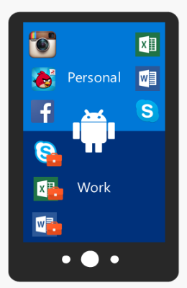




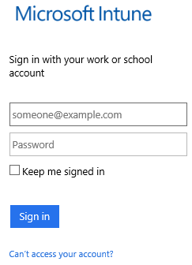



Android device management options
Several options available depending on requirements and device capabilities
Non-managed
Legacy Android
Samsung KNOX
Work profile
Data protection at the app level only. Ideal for:
Cases where device cannot be managed
Older devices that do not support work profile
Conventional MDM management
Supports Android 4.4 and above
Basic MDM policies
“Unknown sources” app installs
Core Android plus additional capabilities:
Kiosk lockdown
App allow/deny
Email profiles
Silent apps and certs
BYOD use case recommended by Google:
Work/personal separation
App config
Robust app deployment

Slide 5
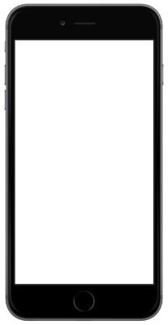
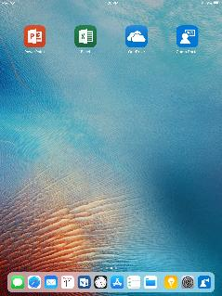
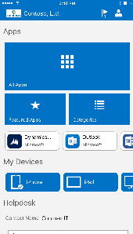
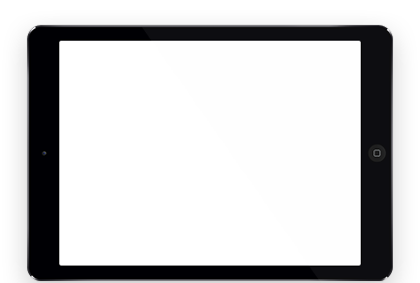
iOS device management options
iOS Non-managed
iOS Managed
Data protection at the app level. Ideal for:
BYOD without full device management
App and data protection using “MAM”
Conventional MDM management. Ideal for:
Configuration for Corp/personal devices
Apple programs VPP, DEP, ASM
Locked down devices: Kiosk, Classroom

Slide 6
The world of MAM
iOS Non-managed
Android Non-managed
Intune App Protection Policies
Intune App Protection Policies

Slide 7
Intune App Protection (MAM)
iOS Non-managed
Android Non-managed
Intune App Protection Policies
Intune App Protection Policies

Slide 8
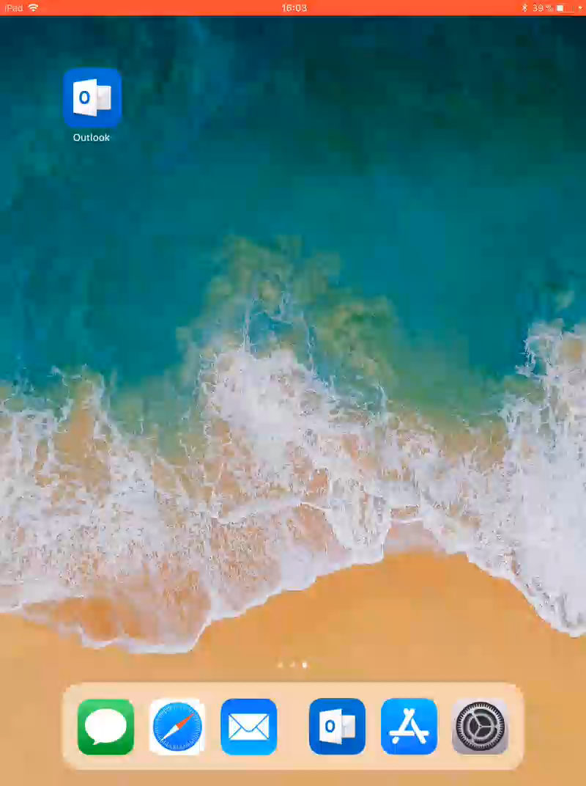

Slide 9
Managing and protecting apps with Microsoft Intune
Deploy
Configure
Protect
Retire

Slide 10
Deploy

Slide 11
Deploy Apps
iOS
Store
VPP
Line of business app
Android
Store
Line of business app
Windows
Store
Line of business app
Windows Store for business
Office 365 Proplus
Web app

Slide 12
Assign apps
Common assignment types: (MDM)
Available - Users install the app from the Company Portal app or website.
Required - The app is installed on devices in the selected groups.
Uninstall - The app is uninstalled from devices in the selected groups.
Not Applicable - The app is not installed or shown in the Company Portal.
Available with or without enrollment for BYOD non-enrolled devices
Assign this app to groups of users whose devices are not enrolled with Intune.
Windows store business apps are upcoming for w/o enrollment support

Slide 13
Configure – BYOD non-enrolled
Part of the Intune SDK
All applications that support Intune MAM-WE today can also take advantage of MAM Application Configuration
Does not require device enrollment
Like Application Protection Policies, MAM Application Configuration works regardless of device management state
Works across platforms (iOS and Android)

Slide 14
MAM App Config: Impact
Partner applications now have the ability to create new configuration features, controlled by Intune
New configuration features can be developed without relying on changes to the Intune service
Can even be used for rapid prototyping
Office applications are already building new features on this pipeline
OneDrive, Outlook, Managed Browser

Slide 15
























Managed Browser
Managed apps
Managed apps
What is it?
Native application for iOS and Android devices
Available on the Apple App Store and Google Play Store
Integrated with the Intune SDK
Restrict features, sharing and downloads
Personal apps
Personal apps

Slide 16
Managed Browser - Scenarios
Main User Scenarios
Supports Intune Application Protection Policies
Admin can control cut/copy/paste, data transfer, etc
Enables protected web browsing with Intune
Utilizes native webview for iOS and Android
Tabbed Browsing, bookmarks
MyApps integration
Support for single sign-on via myapps.Microsoft.com

Slide 17
Managed Browser Configuration Features
URL Allow/Block List
Pre-Configured Homepage
Pre-Configured Bookmarks
On-Prem access with the Azure AD Application Proxy
Users who use the Managed Browser to navigate to internal URLs (http://internal/) are automatically redirected to an Application Proxy endpoint, if one is available for them

Slide 18
Outlook Configuration
Decide what data to be allowed to sync down to Native Contacts
Work Phone
Email Adress
Birthday
IM
+++
Complete list: https://technet.microsoft.com/en-us/library/mt813789(v=exchg.150).aspx

Slide 19
Demo – Configure Apps Outlook and Managed Browser

Slide 20
Protect apps

Slide 21
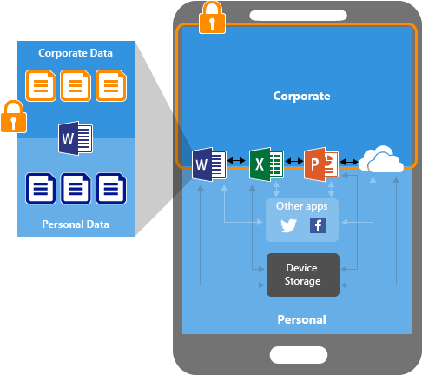
Protect – both MDM + non-enrolled
Works the same for MDM and non-enrolled devices: Intune SDK
Two parts:
App Protection Policies
App Based CA

Slide 22
App Protection Policies
21 SDK-enabled apps on iOS exclusive to Intune
19 SDK-enabled apps on Android exclusive to Intune
Works the same on:
Intune managed devices
3rd party MDM managed devices
Unmanaged devices

Slide 23
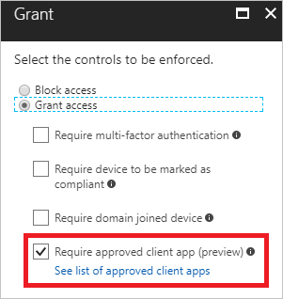
App Based Conditional Access
Block O365 service access to apps that are not protected by Intune Policy

Slide 24










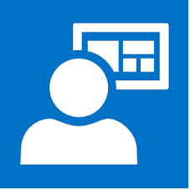






O365 Exchange Online
Request token based on Client ID
Policy Approved Client IDs
Get Corporate
email
Get EXO
Access token
for user
Outlook
Cloud Service
Broker App
Register
Device in
Azure AD
Issue Access Token
Access Outlook
Cloud Service with AAD token
Redirect to App Store
Install App
Outlook App
App Store/Google Play Step1: Install Microsoft Authenticator(iOS) or Company Portal(Android)
Authenticate User and Device
Verify identity of Outlook App
Notes:
The user tries to authenticate to Azure AD from the Outlook app.
The user gets redirected to the app store to install a broker app when trying to authenticate for the first time. The broker app can be either the Microsoft Authenticator for iOS, or the Microsoft Company portal for Android devices.
If users try to use a native e-mail app, they’ll be redirected to the app store to then install the Outlook app.
The broker app gets installed on the device.
The broker app starts the Azure AD registration process which creates a device record in Azure AD. This is not the same as the mobile device management (MDM) enrollment process, but this record is necessary so the conditional access policies can be enforced on the device.
The broker app verifies the identity of the app. There’s a security layer so the broker app can validate if the app is authorized to be used by the user.
The broker app sends the App Client ID to Azure AD as part of the user authentication process to check if it’s in the policy approved list.
Azure AD allows the user to authenticate and use the app based on the policy approved list. If the app is not on the list, Azure AD denies access to the app.
The Outlook app communicates with Outlook Cloud Service to initiate communication with Exchange Online.
Outlook Cloud Service communicates with Azure AD to retrieve Exchange Online service access token for the user.
The Outlook app communicates with Exchange Online to retrieve the user's corporate e-mail.
Corporate e-mail is delivered to the user's mailbox.

Slide 25
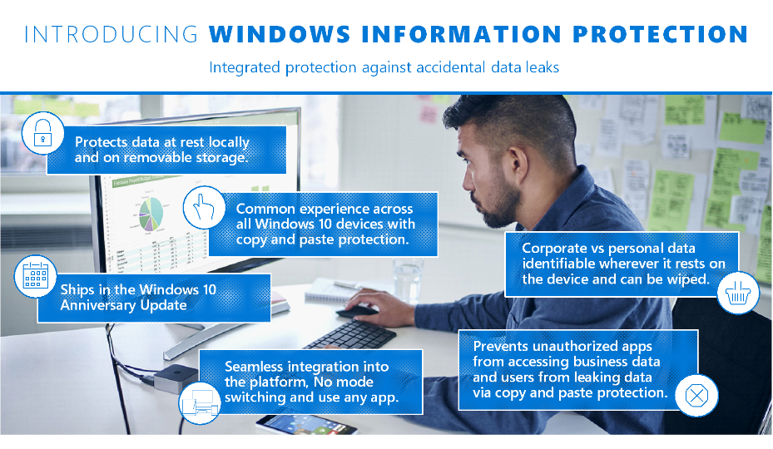
Windows 10 support with Windows Information Protection

Slide 26
Quick Tip: Block One App from Mobile
Set Required version to something high (999.99)

Slide 27
Demo – Protect Windows 10 MAM-WE

Slide 28
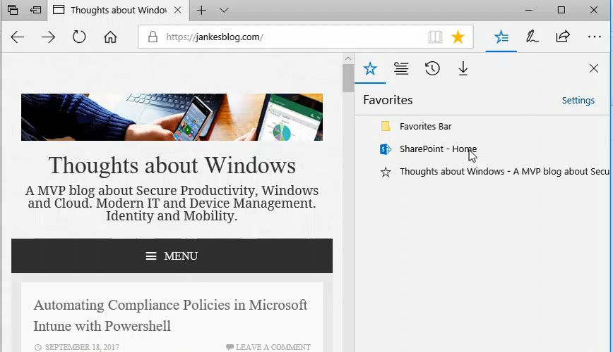

Slide 29
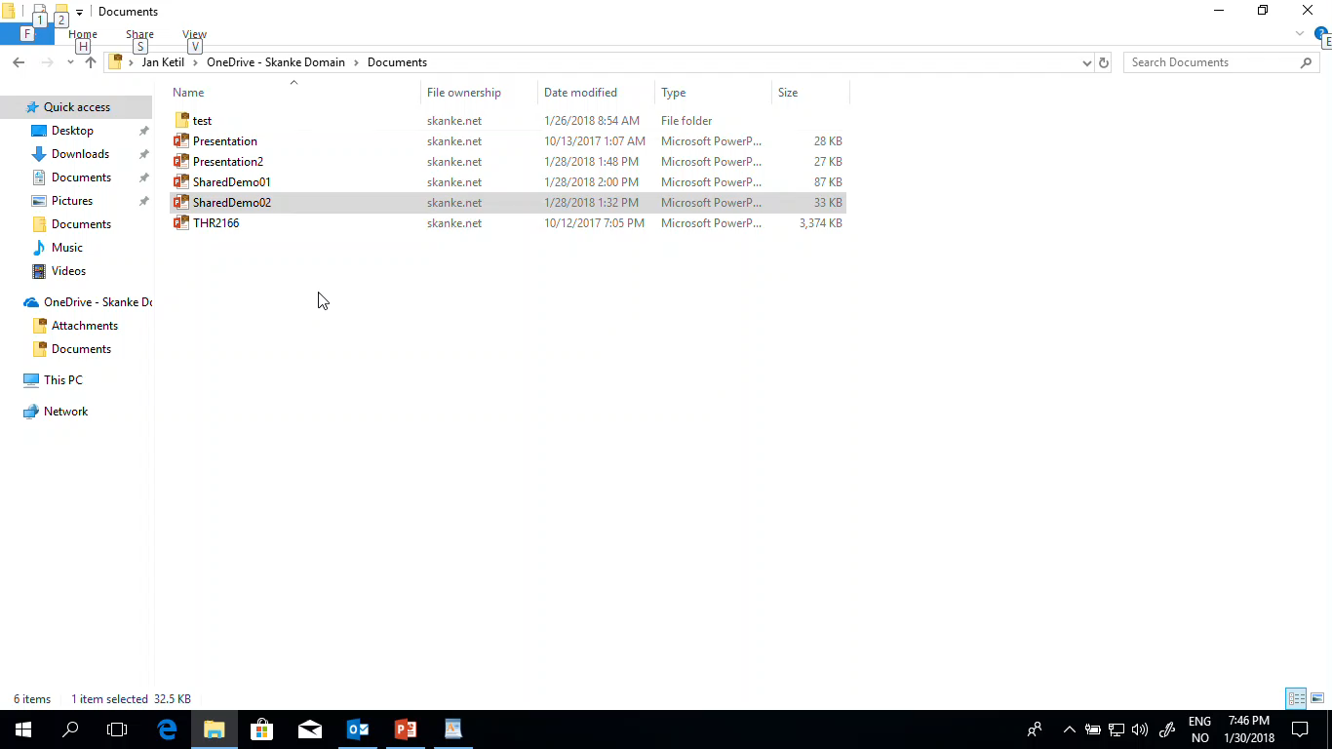

Slide 30
Demo – Protect iOS – MAM-WE

Slide 31
Caveats 01
Conditional Access Policies does not support legacy auth
Consider blocking Legacy Auth
Sharepoint Online – OK
Other needs ADFS
Look into Exchange Client Access Rules for Exchange Online to avoid ADFS
New-ClientAccessRule -Name "Block ActiveSync" -Action DenyAccess -AnyOfProtocols ExchangeActiveSync
https://technet.microsoft.com/en-us/library/mt842508(v=exchg.150).aspx

Slide 32
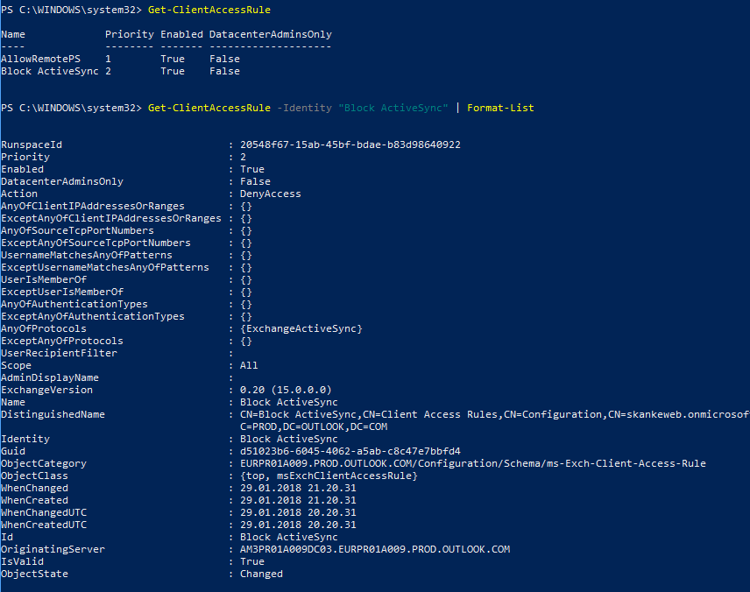

Slide 36
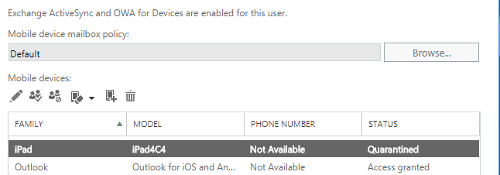

Slide 37
Caveats 02
Outlook Mobile Add-ins might allow user to leak data
To prevent users from adding Office Store add-ins, remove the My Marketplace role from them.
To prevent users from loading add-ins from sources other than the Office Store, remove the My Custom Apps role from them.
https://technet.microsoft.com/en-us/library/mt842508(v=exchg.150).aspx

Slide 38
Retire apps

Slide 39
Retire – BYOD non-enrolled
App selective wipe
Monitor pending wipe
Next Sync will wipe the App
No effect on private accounts or data on the device

Slide 40
Demo Retire

Slide 41
Recap
Deploy
Configure
Protect
Retire

Slide 42
Resources
Slides and demos from the conference will be available at github.com/nordicinfrastructureconference/2018 (bit.ly/2y7JhA3)
Thank You!!

